Slide 1
Secure your microservices with istio step by step
JianFeng Ding, LuYao Zhong

Slide 2
Agenda
Istio identity
mTLS in Isito
Secure ingress traffic
Authorize ingress traffic
Authorize in mesh traffic
Summary

Slide 3
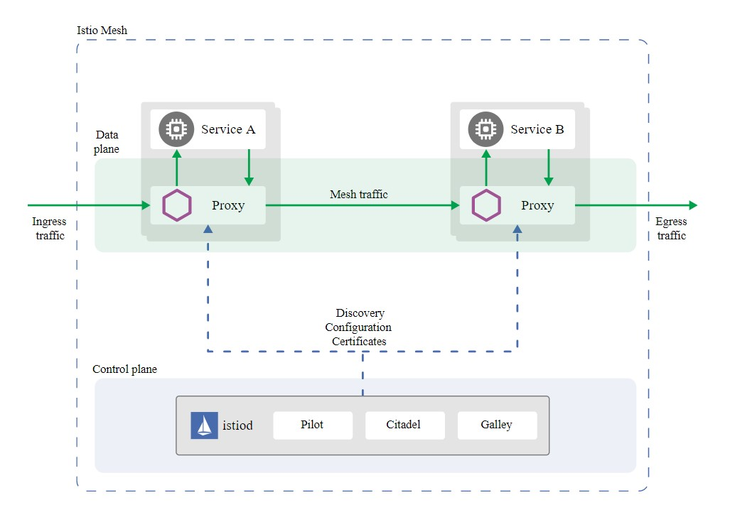
Istio Architecture
Connect, secure, control, and observe services.

Slide 4
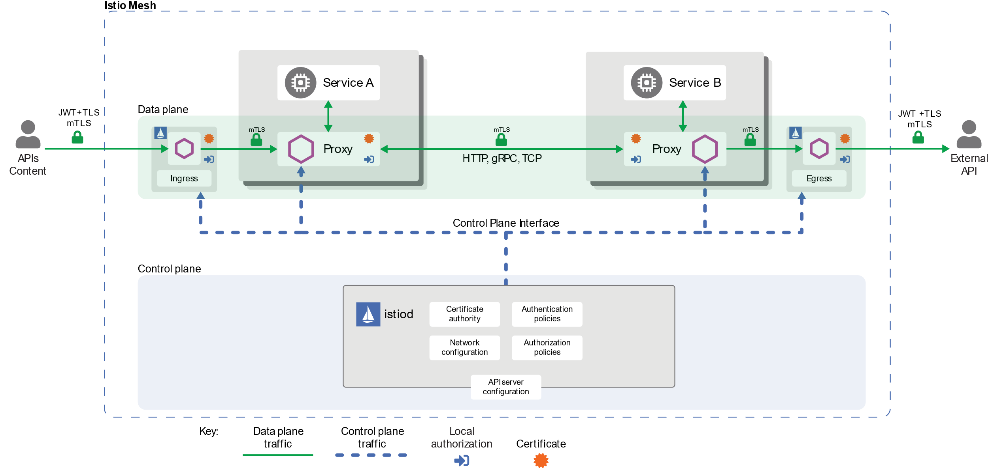
Security Architecture

Slide 5
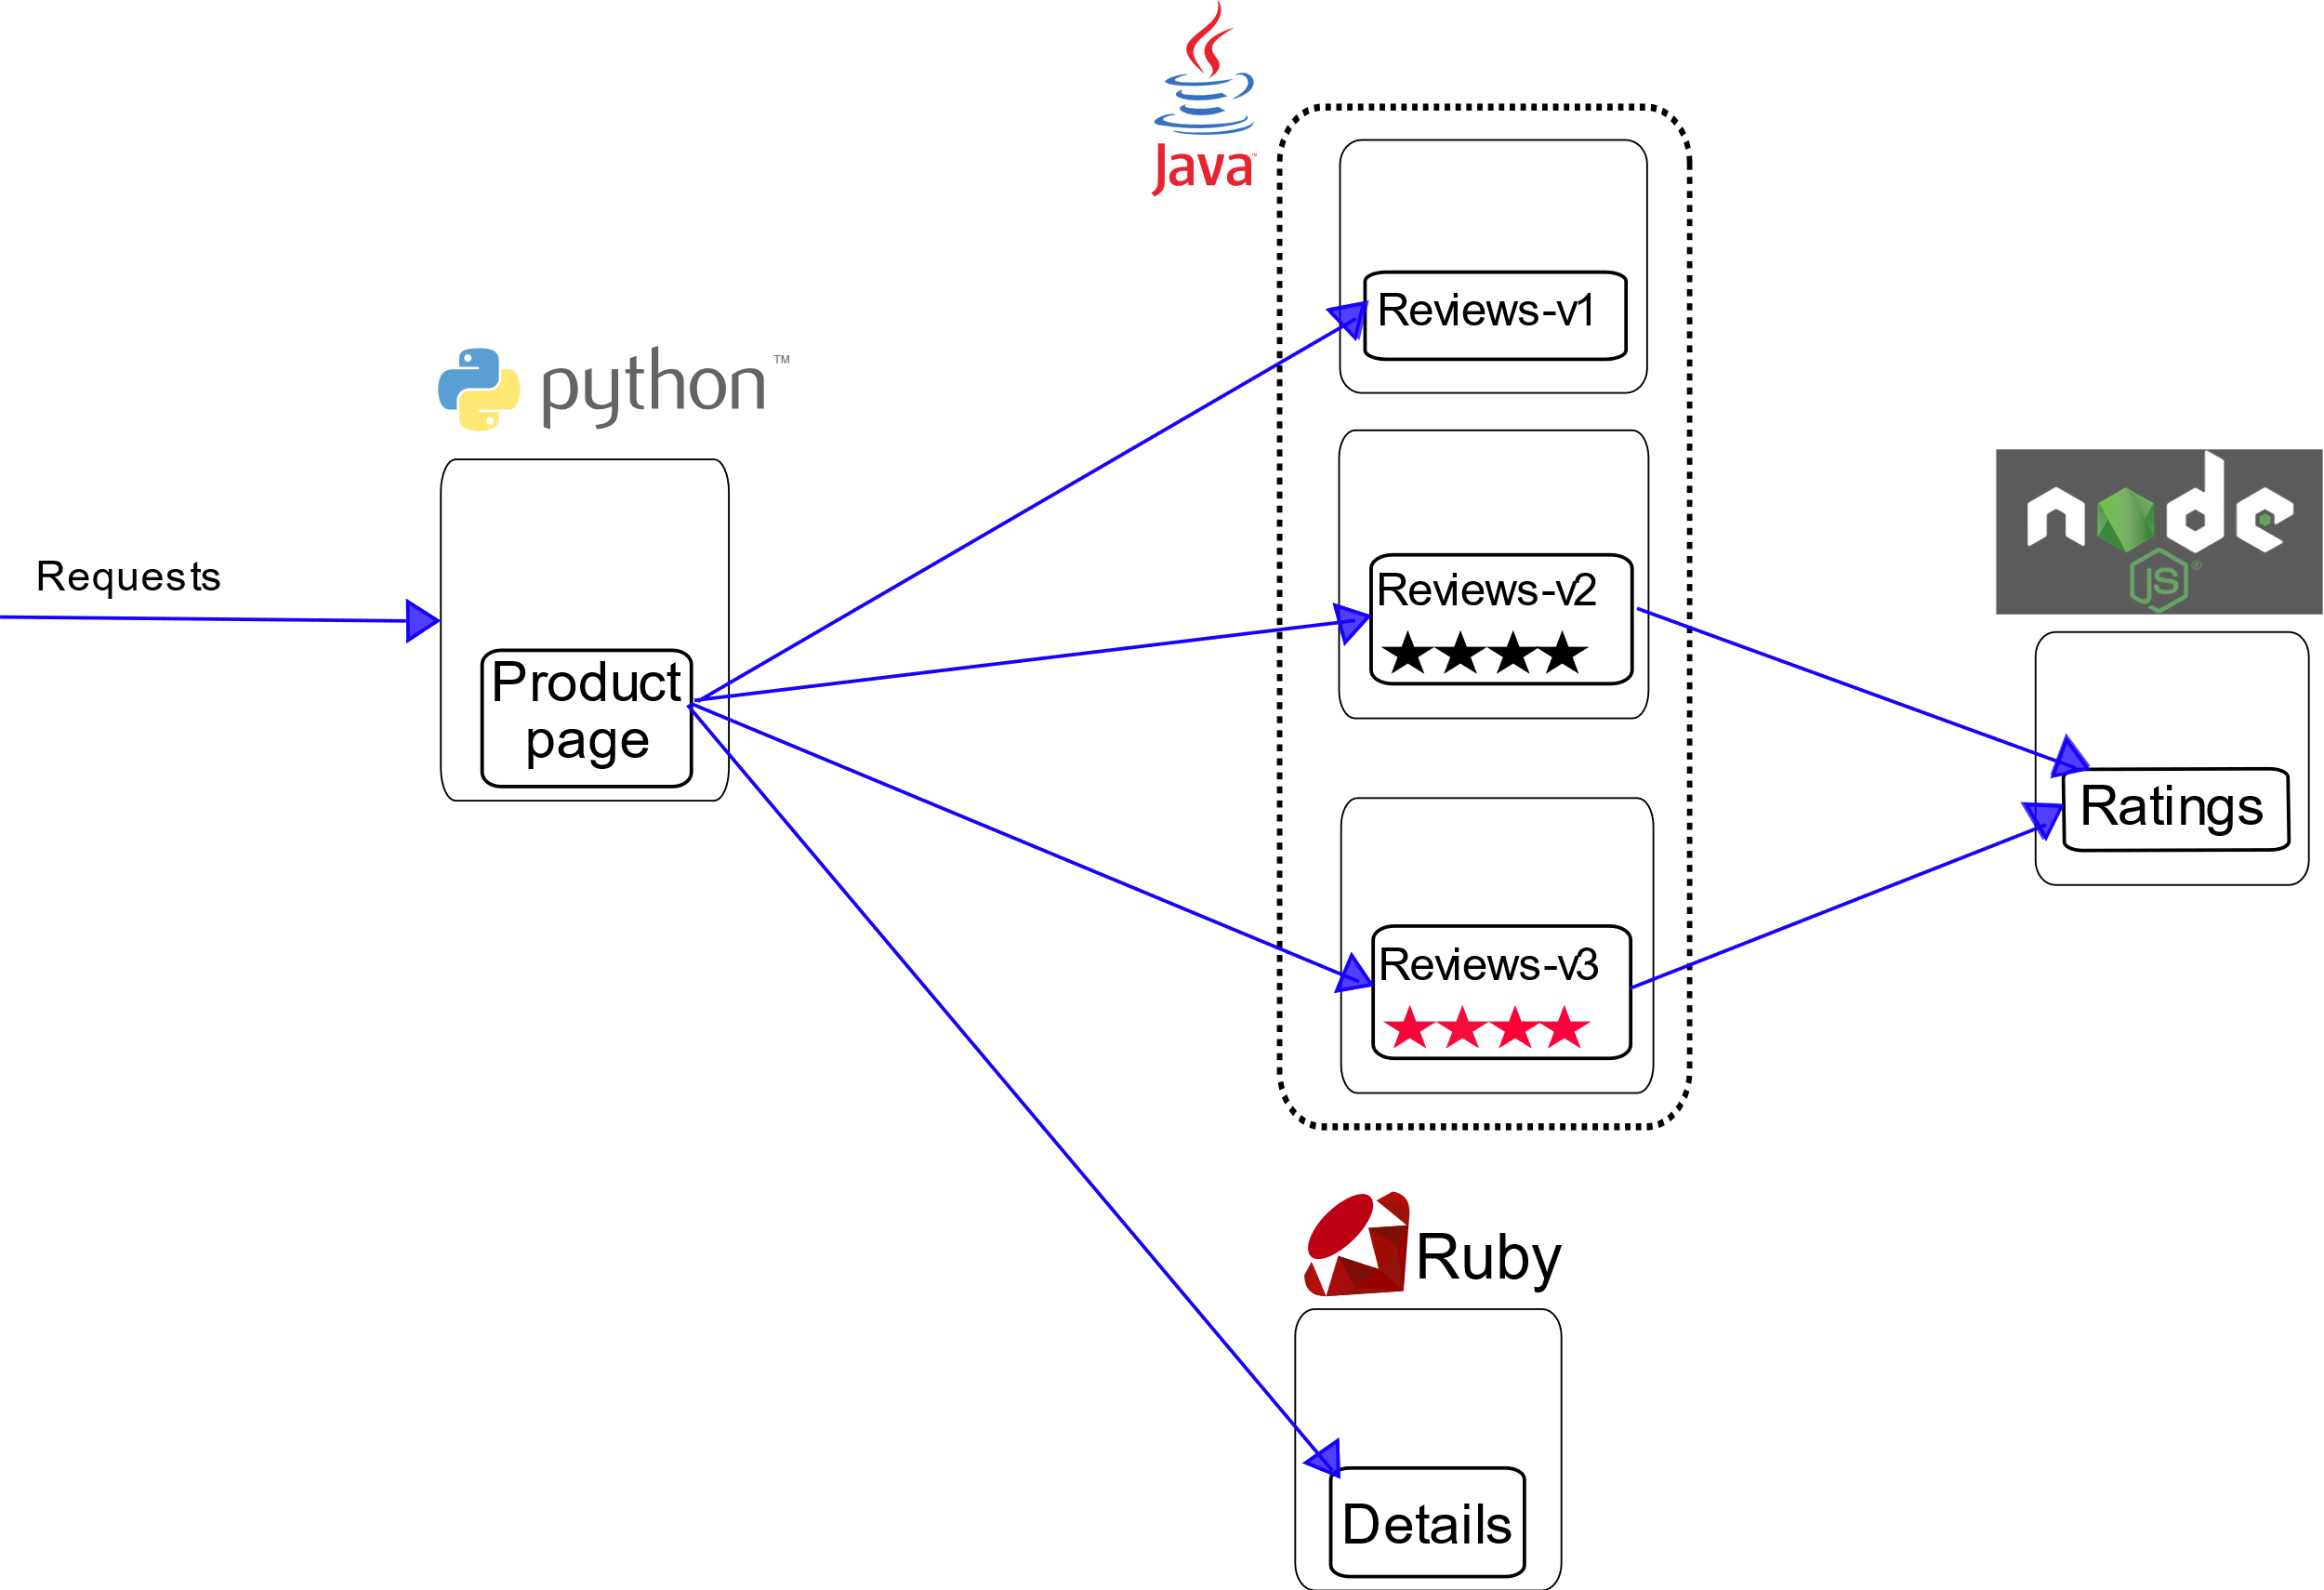
Bookinfo architecture without service mesh
Reviews-v1
doesn’t call the ratings service.
Reviews-v2
calls ratings, black stars
Reviews-v3
calls ratings, red stars

Slide 6
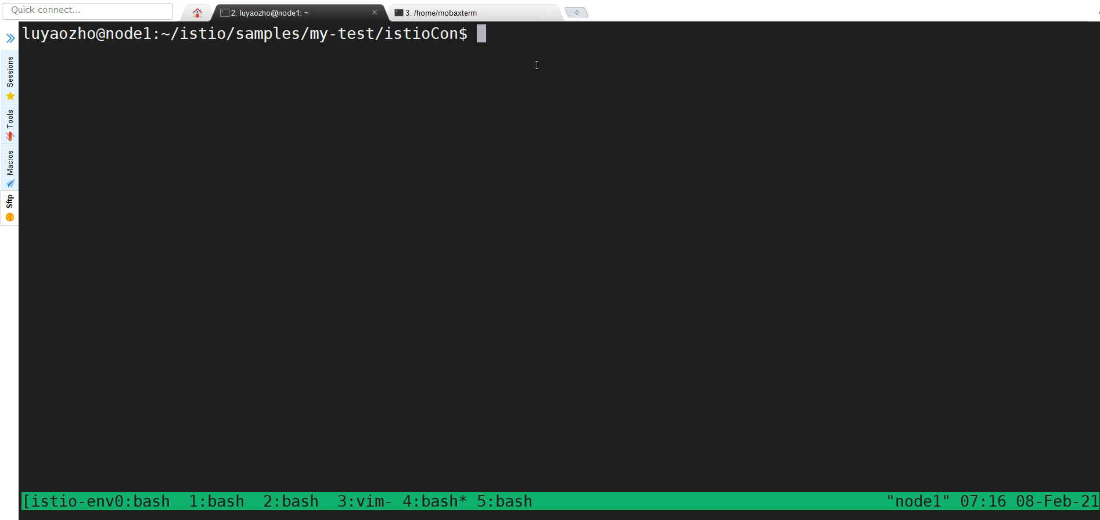
Initializing services
Deploy bookinfo services with istio sidecar without reviews-v2
Deploy bookinfo gateway
Deploy reviews-v2 service without istio sidecar
（kubectl label namespace default istio-injection=disabled/enabled）
Notes:
We modify the application setting up steps to easy showing how to secure your microservices. So please notice that it’s not completely the same as the original sample configuration

Slide 7
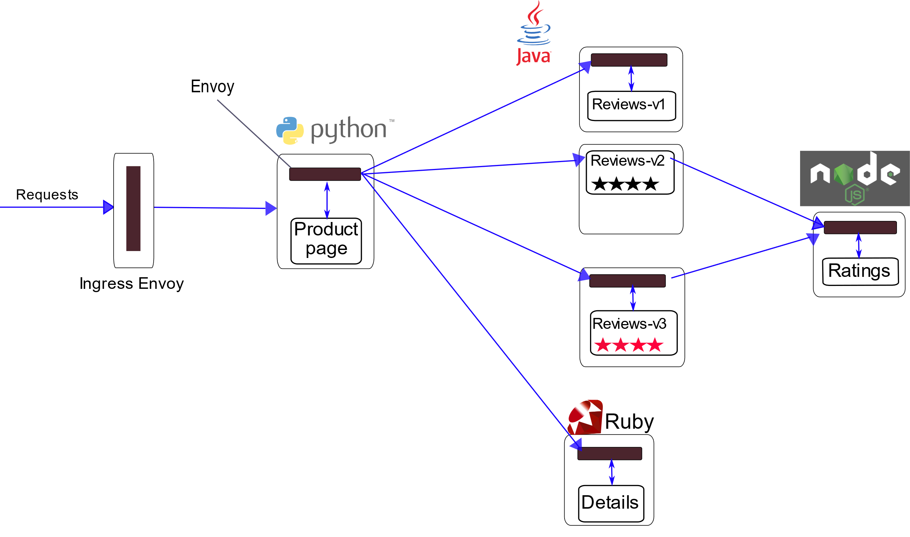
Initializing services
Deploy bookinfo services with istio sidecar without reviews-v2
Deploy bookinfo gateway
Deploy reviews-v2 service without istio sidecar
（kubectl label namespace default istio-injection=disabled/enabled）
http
http
http
http
http
http
http

Slide 8
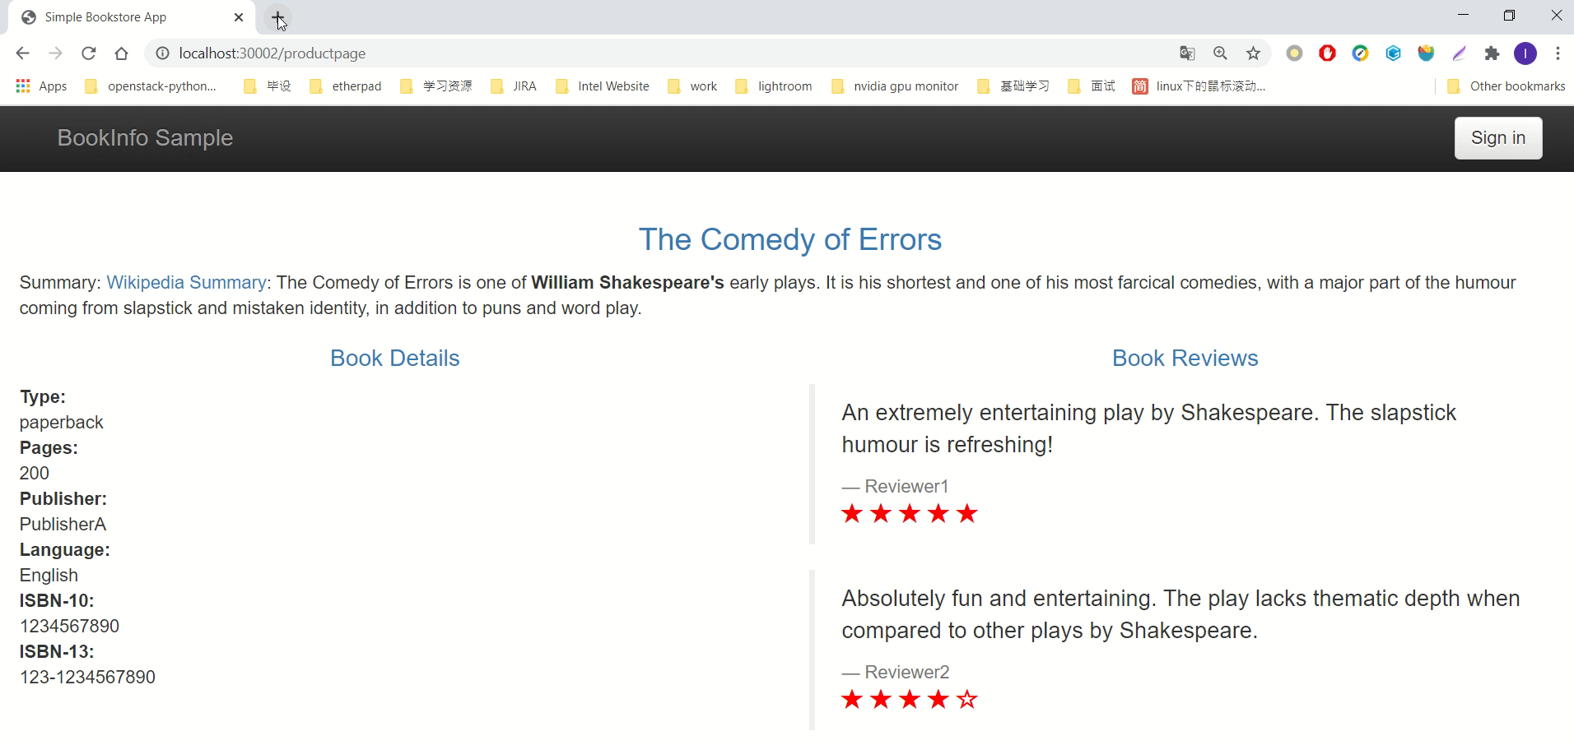
Access productpage
Result:
can access reviews-v1, reviews-v2 and reviews-v3
Notes:
$ export INGRESS_PORT=$(kubectl -n istio-system get service istio-ingressgateway -o jsonpath='{.spec.ports[?(@.name=="http2")].nodePort}’) # Get Ingress Port
$ export INGRESS_HOST=$(kubectl get pod -l istio=ingressgateway -n istio-system -o jsonpath='{.items[0].status.hostIP}’) # Get Ingress Host
https://preliminary.istio.io/latest/docs/tasks/traffic-management/ingress/ingress-control/#determining-the-ingress-ip-and-ports

Slide 9
Istio Identity
Istio Agent
1. Start Envoy
Envoy
2. Request Cert (SDS))
Istio-proxy
3. CSR
Auth: JWT
4. Cert signed with SPIFFE format
Istiod
CA server

Slide 10
Istio identity – how to get configuration
Format: "spiffe://<domain>/ns/<namespace>/sa/<serviceaccount>”
istioctl proxy-config secret <POD> -o json | jq '.dynamicActiveSecrets[0].secret.tlsCertificate.certificateChain.inlineBytes' -r | base64 -d | openssl x509 -noout -text -in -
Part of cluster config in envoy config-dump
kubectl exec <POD> -c istio-proxy curl localhost:15000/config_dump

Slide 11
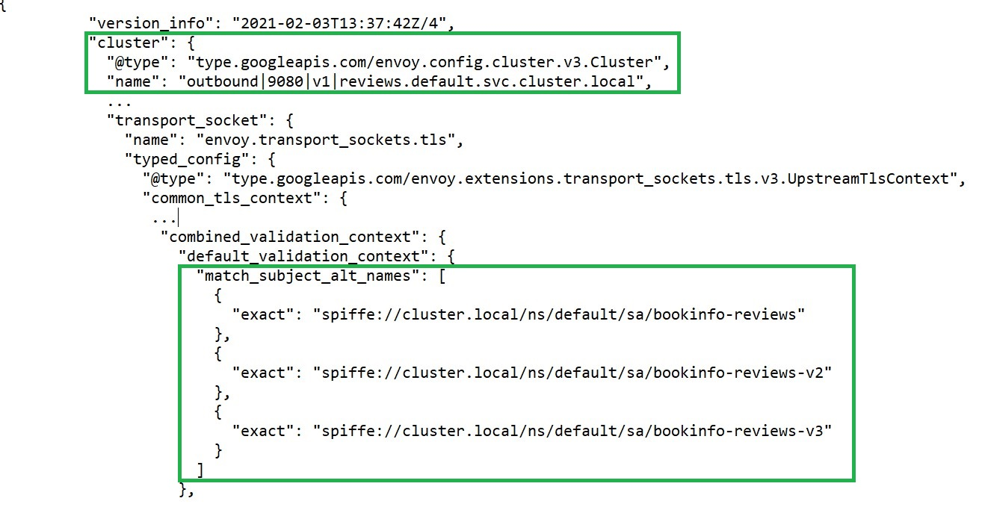
Istio identity – check configuration result
Result: cert generated automatically with Istio identity

Slide 12
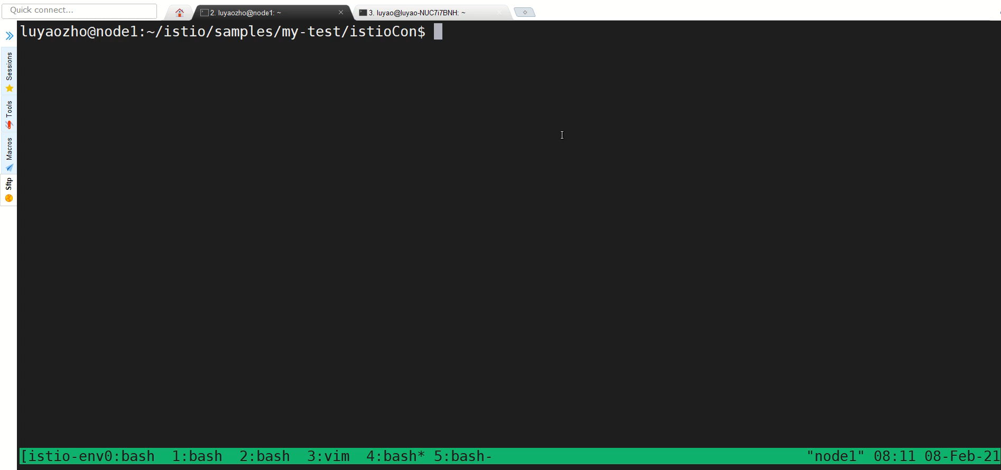
mTLS in Istio - PeerAuthentication
Apply peer-authentication to enable server side mTLS
Notes:
$ export INGRESS_PORT=$(kubectl -n istio-system get service istio-ingressgateway -o jsonpath='{.spec.ports[?(@.name=="http2")].nodePort}’) # Get Ingress Port
$ export INGRESS_HOST=$(kubectl get pod -l istio=ingressgateway -n istio-system -o jsonpath='{.items[0].status.hostIP}’) # Get Ingress Host
https://preliminary.istio.io/latest/docs/tasks/traffic-management/ingress/ingress-control/#determining-the-ingress-ip-and-ports

Slide 13
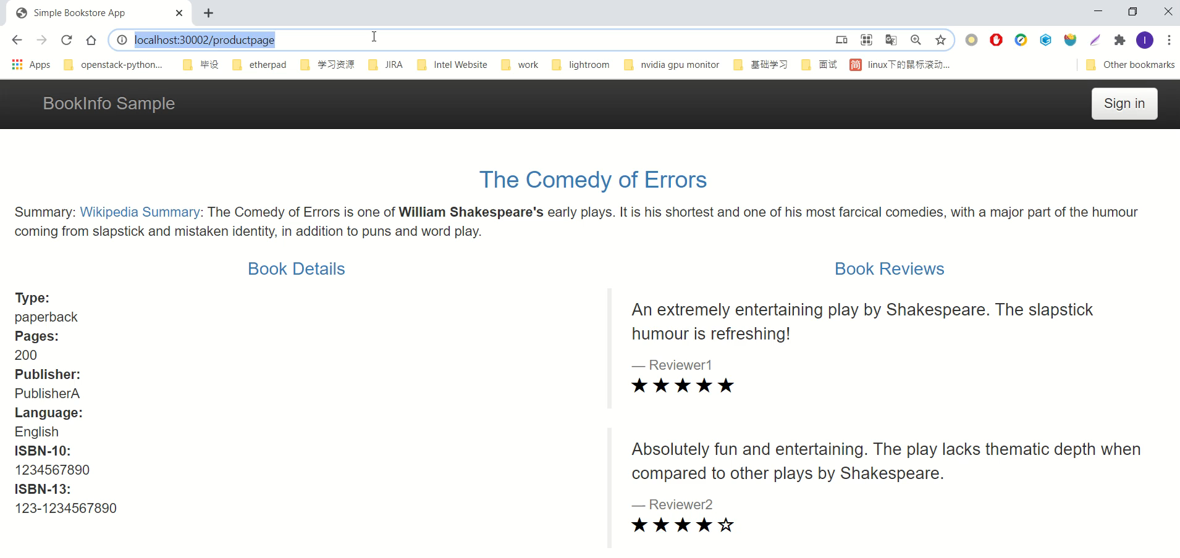
Access productpage
Using ingress port and ingress host to send request:
can access reviews-v1, reviews-v2 and reviews-v3
can reach v2 as peer-authentication only defines behavior of server side and auto-mTLS is on by default
Notes:
This peer authentication policy configures workloads to only accept requests encrypted with TLS

Slide 14
mTLS in Istio - PeerAuthentication
Apply peer-authentication to enable server side mTLS
mTLS
http
http
http
mTLS
http
http
Notes:
$ export INGRESS_PORT=$(kubectl -n istio-system get service istio-ingressgateway -o jsonpath='{.spec.ports[?(@.name=="http2")].nodePort}’) # Get Ingress Port
$ export INGRESS_HOST=$(kubectl get pod -l istio=ingressgateway -n istio-system -o jsonpath='{.items[0].status.hostIP}’) # Get Ingress Host
https://preliminary.istio.io/latest/docs/tasks/traffic-management/ingress/ingress-control/#determining-the-ingress-ip-and-ports

Slide 15
Auto-mTLS in Istio
Decide what type of traffic the client sidecar to send automatically
If DestinationRule is configured, respect it
If server has a sidecar and allows mTLS, send mTLS – reviews-v1 & v3
Otherwise, send plain text – reviews-v2
Server side will be in PERMISSIVE mode by default

Slide 16
mTLS in Istio - PeerAuthentication
Defines what type of traffic the server sidecar will accept
apiVersion: "security.istio.io/v1beta1“
kind: "PeerAuthentication“
metadata:
name: "demo-peer-policy“
namespace: "default“
spec:
selector:
matchLabels:
app: reviews
mtls:
mode: STRICT
PERMISSIVE: accepts for both plain text and mTLS
STRICT: accepts only mTLS
DISABLE: accept only plain text
UNSET: inherit from parent, default to PERMISSIVE if no set

Slide 17
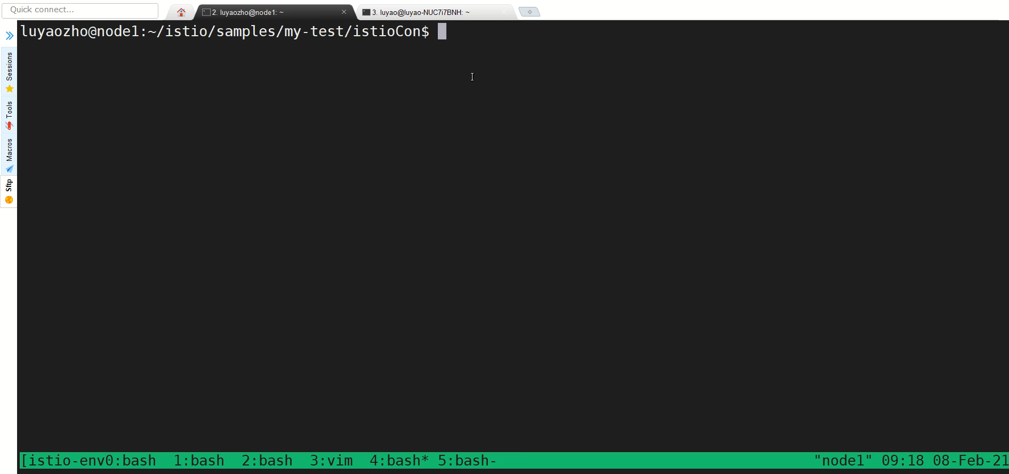
mTLS in Istio - Destination rule
Apply destination rule to enable client side mTLS

Slide 18
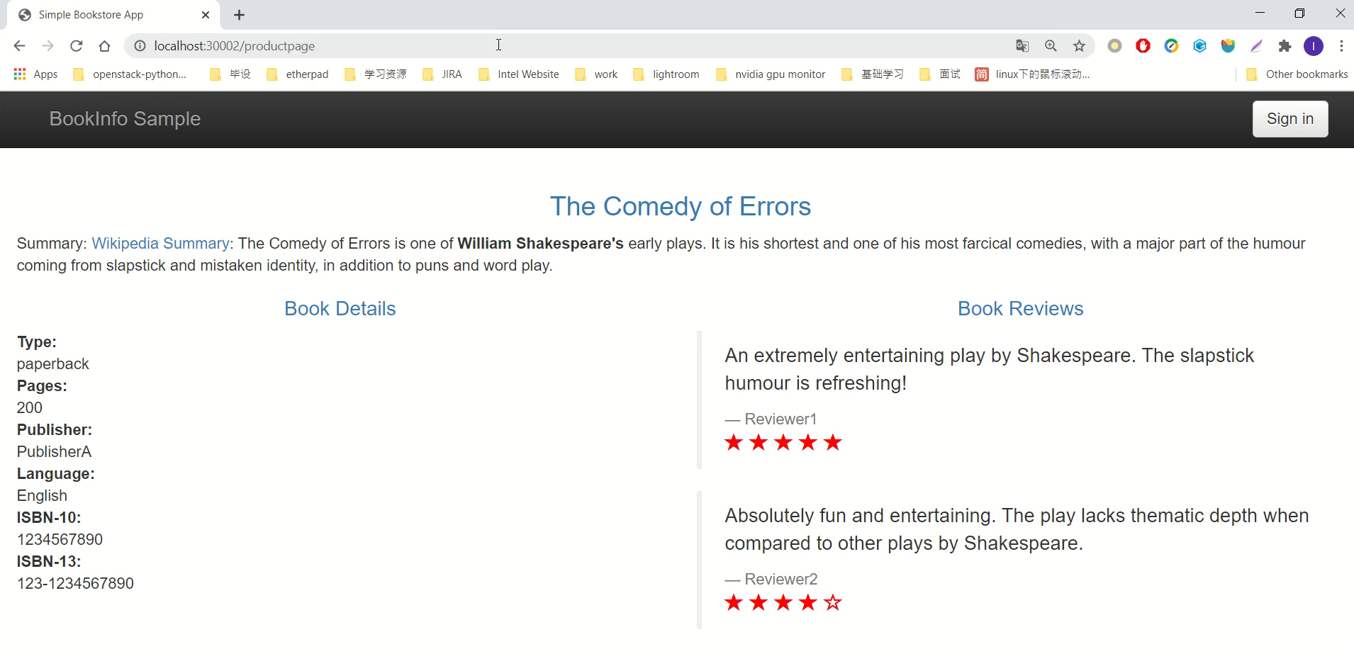
Access productpage
Using ingress port and ingress host to send request:
can access reviews-v1, reviews-v3
can not access reviews-v2 since we have enabled ISTIO_MUTUAL mode on client side

Slide 19
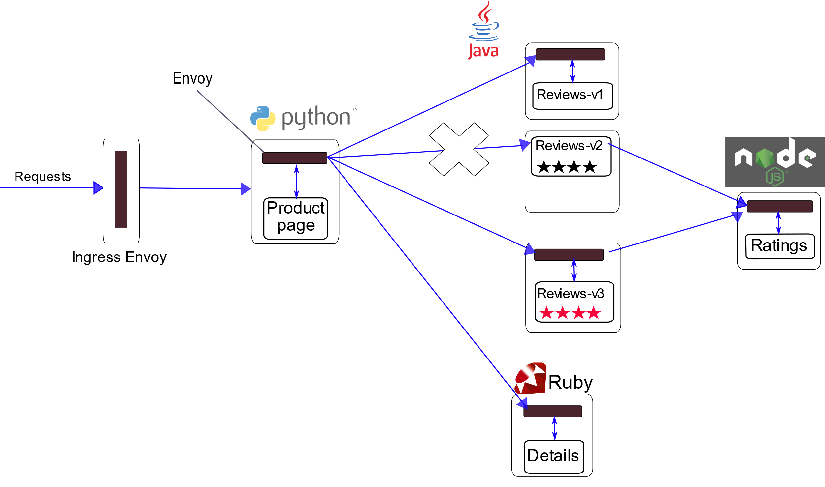
mTLS in Istio - Destination rule
Apply destination rule enable client side mTLS
mTLS
http
http
http
mTLS
http
Notes:
To set a peer authentication policy for a specific workload, you must configure the selector section and specify the labels that match the desired workload. However, Istio cannot aggregate workload-level policies for outbound mutual TLS traffic to a service. Configure a destination rule to manage that behavior.

Slide 20
mTLS in Istio - DestinationRule
Defines what type of traffic the client sidecar will send
apiVersion: networking.istio.io/v1alpha3
kind: DestinationRule
metadata:
name: reviews
spec:
host: reviews
trafficPolicy:
tls:
mode: ISTIO_MUTUAL
DISABLE: send plain text, common for services outside of the mesh
ISTIO_MUTUAL: originate TLS with istio cert
SIMPLE/MUTUAL: originate TLS with the cert you specified, common if you want to TLS with service outside mesh

Slide 21
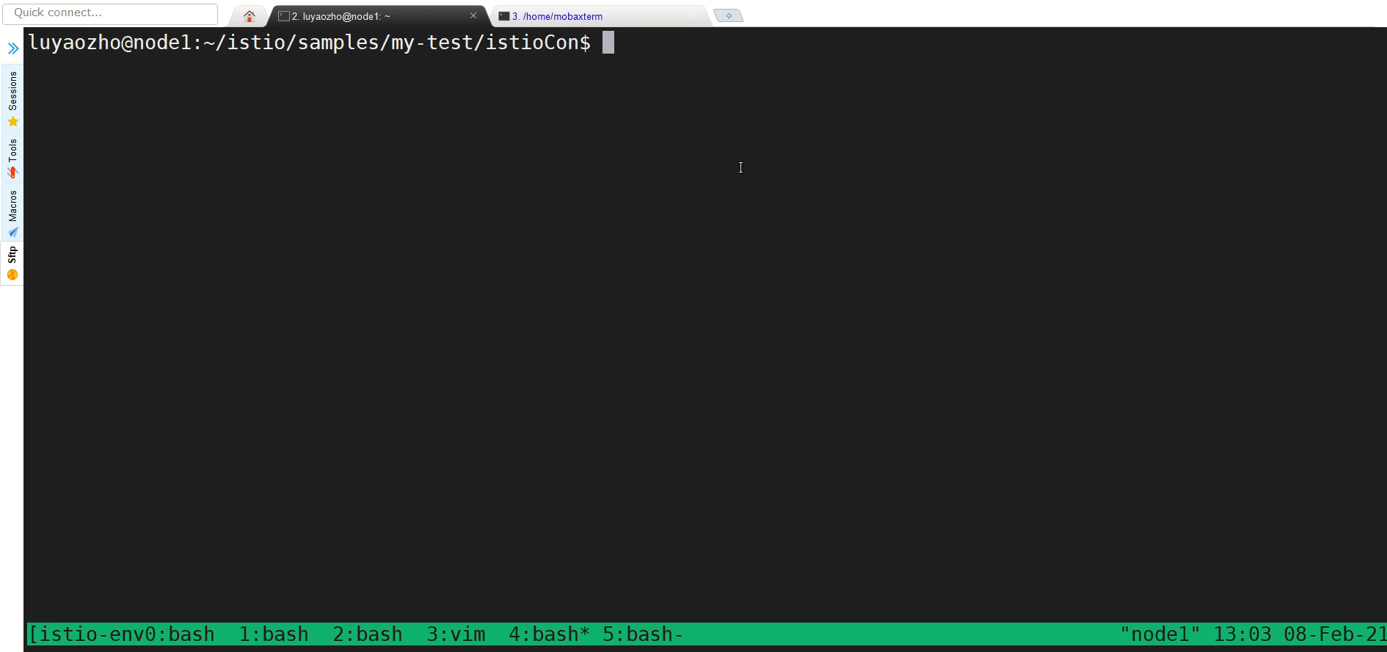
Secure ingress gateway via TLS terminating
Generate client and server certificates and keys
Create a secret for the ingress gateway: productpage-credential
Define a gateway which specifying above secret and define corresponding virtual service which configuring traffic routes

Slide 22
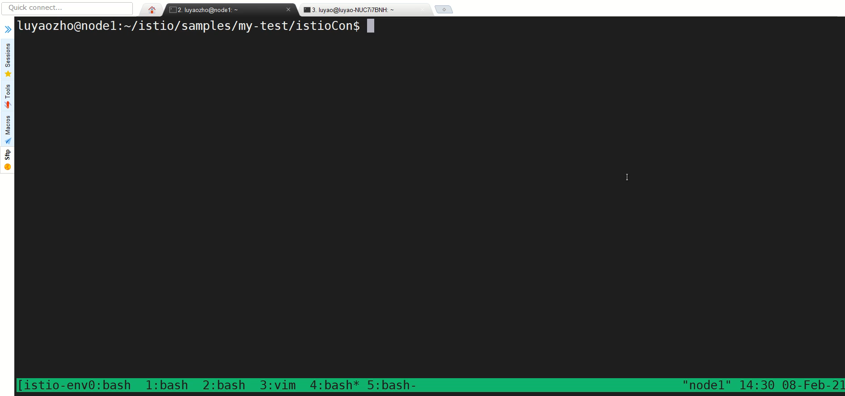
Access productpage
Using ingress host and secure ingress port to send request:
From curl command: need attaching certificate file
Notes:
export SECURE_INGRESS_PORT=$(kubectl -n istio-system get service istio-ingressgateway -o jsonpath='{.spec.ports[?(@.name=="https")].nodePort}')

Slide 23
Secure ingress gateway via TLS terminating
Generate client and server certificates and keys
Create a secret for the ingress gateway: productpage-credential
Define a gateway which specifying above secret and define corresponding virtual service which configuring traffic routes
mTLS
http
http
https
mTLS
http

Slide 24
Secure ingress traffic
apiVersion: networking.istio.io/v1alpha3
kind: Gateway
metadata:
name: bookinfo-gateway
spec:
selector:
istio: ingressgateway # use istio default controller
servers:
- port:
number: 443
name: https
protocol: HTTPs
tls:
mode: SIMPLE
credentialName: productpage-credential
hosts: - "*"
SIMPLE/ MUTUAL: terminate TLS in gateway, need to specify cert
ISTIO_MUTUAL: terminate TLS in gateway using istio cert
PASSTHROUGH: pass through the TLS traffic using SNI and virtual Service
AUTO_PASSTHROUGH: pass through the TLS traffic purely using SNI without VS

Slide 25
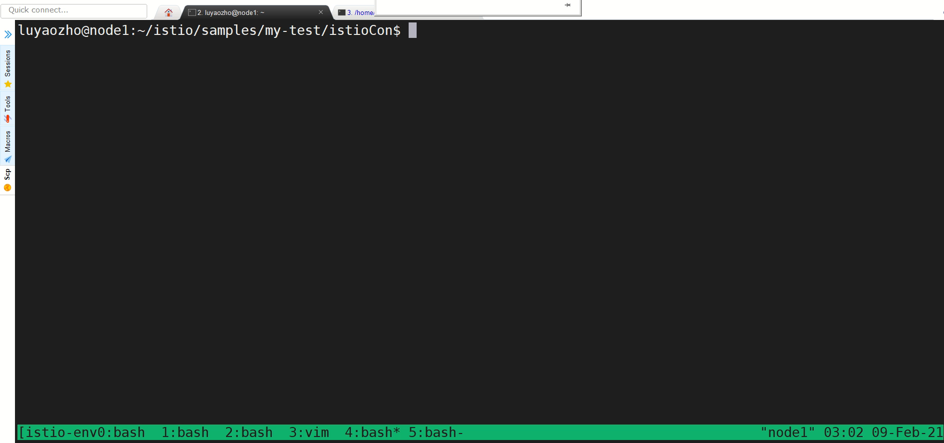
Authorize ingress traffic via JWT
Apply RequestAuthentication to ingress gateway

Slide 26
Authorize ingress traffic via JWT
Apply RequestAuthentication to ingress gateway
mTLS
http
http
https +
JWT
mTLS
http

Slide 27

Access productpage
Send request via curl command：
Invalid token can not pass the gateway, only valid token does
Delete JWT authentication request, invalid token can pass the gateway

Slide 28
Authorize ingress traffic with JWT token
apiVersion: "security.istio.io/v1beta1“
kind: "RequestAuthentication“
metadata:
name: "jwt-example“
namespace: istio-system
spec:
selector:
matchLabels:
istio: ingressgateway
jwtRules:
- issuer: testing@secure.istio.io
jwksUri: "https://raw.githubusercontent.com/istio/istio/release-1.8/security/tools/jwt/samples/jwks.json"
apiVersion: security.istio.io/v1beta1
kind: AuthorizationPolicy
metadata:
name: require-jwt
namespace: istio-system
spec:
action: ALLOW
rules:
- from:
- source:
requestPrincipals: ["testing@secure.istio.io/testing@secure.istio.io"]

Slide 29


Authorize ingress traffic with JWT token
Apply RequestAuthentication
Results:
request with valid jwt token
request without jwt token
request with invalid jwt token
Apply AuthorizationPolicy
Results:
request with valid jwt token
request without jwt token
request with invalid jwt token

Slide 30
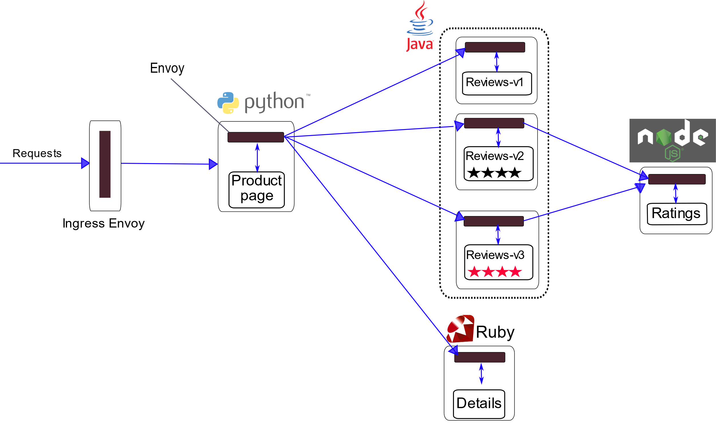
6. Authorize in mesh traffic
Redeploy bookinfo sample services with http protocol and with sidecar injected
Apply deny-all authorization policy
Apply prouctpage-viewer policy
Apply details-viewer policy
Apply reviews-viewer policy
Apply ratings-viewer policy
1) Apply deny-all authorization policy
2) Apply prouctpage-viewer policy
3) Apply details-viewer policy
4) Apply reviews-viewer policy
5) Apply ratings-viewer policy

Slide 31
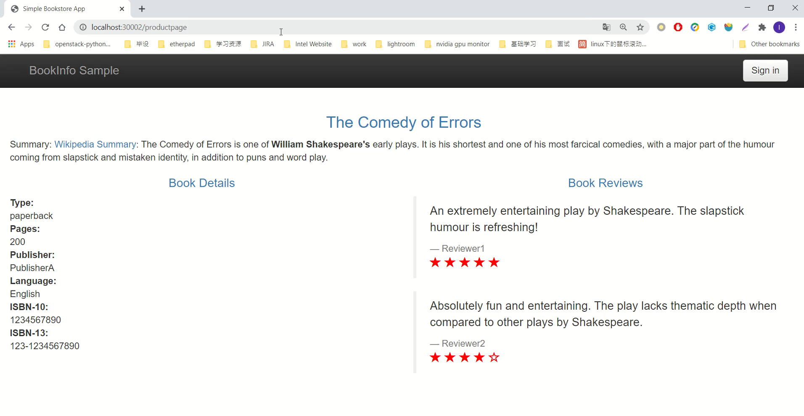
6. Authorize in mesh traffic
Redeploy bookinfo sample services with http protocol and with sidecar injected
Apply deny-all authorization policy
Apply prouctpage-viewer policy
Apply details-viewer policy
Apply reviews-viewer policy
Apply ratings-viewer policy

Slide 32
Authorize in mesh traffic
apiVersion: security.istio.io/v1beta1
kind: AuthorizationPolicy
metadata:
name: deny-all
namespace: default
spec:
{}
apiVersion: "security.istio.io/v1beta1"
kind: "AuthorizationPolicy"
metadata:
name: "details-viewer"
namespace: default
spec:
selector:
matchLabels:
app: details
rules:
- from:
- source:
principals: ["cluster.local/ns/default/sa/bookinfo-productpage"]
to:
- operation:
methods: ["GET"]"
apiVersion: "security.istio.io/v1beta1"
kind: "AuthorizationPolicy"
metadata:
name: "reviews-viewer"
namespace: default
spec:
selector:
matchLabels:
app: reviews
rules:
- from:
- source:
principals: ["cluster.local/ns/default/sa/bookinfo-productpage"]
to:
- operation:
methods: ["GET"]"
apiVersion: "security.istio.io/v1beta1"
kind: "AuthorizationPolicy"
metadata:
name: "productpage-viewer"
namespace: default
spec:
selector:
matchLabels:
app: productpage
rules:
- to:
- operation:
methods: ["GET"]
apiVersion: "security.istio.io/v1beta1“
kind: "AuthorizationPolicy“
metadata:
name: "ratings-viewer“
namespace: default
spec:
selector:
matchLabels:
app: ratings
rules:
- from:
- source:
principals: ["cluster.local/ns/default/sa/bookinfo-reviews", "cluster.local/ns/default/sa/bookinfo-reviews-v2", "cluster.local/ns/default/sa/bookinfo-reviews-v3""]
to:
- operation:
methods: ["GET"]

Slide 33
Summary
Istio provides strong identify automatically
Auto-mTLS will help you on board to Istio
Strict mTLS if possible
Secure your ingress
Enable Access Control to your services via Istio authorization policy
Istio will Secure your microservices for you!

Slide 34
Thank you!

